Slide 1

Implementation of a Traffic Control System using a Timer
AMERICAN INTERNATIONAL UNIVERSITY – BANGLADESH (AIUB)
Where leaders are created
By Nirjhor Rouf

Slide 2
Problem Statement
Make three LEDs blink and implement a simple traffic light control system while using an Arduino system frequency (F_CPU) of 16 MHz using a timer to generate the delay without any application of the delay() function.

Slide 3
Problem Solution
We will change the code used for controlling the traffic lights in experiment # 1 by simply replacing the delay functions with a function written by us that will use the timer.
The function will accept an input argument mentioning the number of seconds of delay and run a nested if loop.

Slide 4


Timer Basics: Registers (Timer0)
Timer/Counter Control Register A for Timer0 – TCCR0A: The bits WGM02 (from TCCR0B), WGM01 and WGM00 decide which mode the timer will run on.
Timer/Counter Control Register B for Timer0 – TCCR0B: The three Clock Select bits- CS02, CS01, and CS00 select the clock source and pre-scalar value to be used by the Timer/Counter

Slide 5
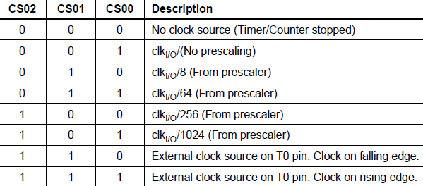
Timer Basics: Registers (Timer0)
Please note that if you do not initialize this register, all the bits will remain as zero and the timer/counter will remain stopped.

Slide 6

Timer Basics: Registers (Timer0)
Timer/Counter Register – TCNT0:
This is where the 8-bit counter of the timer resides.
The value of the counter is stored here and increases or decreases automatically.
Data can be both read or written from this register.
The register resets to zero after each overflow.

Slide 7



Timer Basics: Registers (Timer0)
Timer/Counter Interrupt Flag Register– TIFR0:
TOV0 bit is set (one) whenever TIMER0 overflows.
Output Compare Register - OCR0A and OCR0B:
Both Output Compare Registers A and B contain 8-bit values that are continuously compared with the counter value (TCNT0). The OCF0A or OCF0B bit in the TIFR register is set (one) whenever the count matches the stored value.

Slide 8
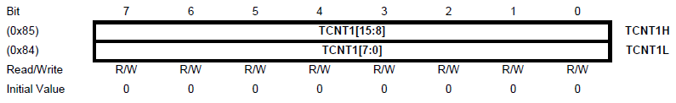
Timer Basics: Registers (Timer1)
Most of the registers are very similar to Timer0.
Timer/Counter Register – TCNT1H and TCNT1L (TCNT1):
The main difference between Timer0 and Timer1 is in the timer/counter register.
The two Timer/Counter I/O locations (TCNT1H and TCNT1L, combined TCNT1 of 16-bit) give direct access, both for read and write operations, to the Timer/Counter unit 16-bit counter.
The register resets to zero after each overflow.

Slide 9
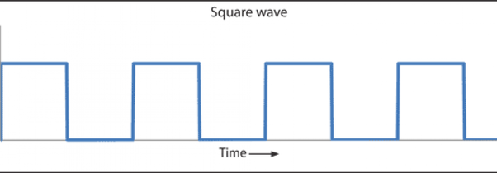
Timer for Delay: Calculating Count
Timer needs a clock pulse for each transition from one number to the next, so we want to establish a formula relating the necessary timer count for a specific delay with the timer clock period/frequency.
For F_CPU = 16 MHz, system clock period = 1/16MHz = 62.5 ns. So, if timer clock is the same as system clock, it takes only 62.5 ns for every transition (0 to 1, 1 to 2, etc.).
187.5 ns
62.5 ns
62.5 ns
62.5 ns
Count = 0
Count = 1
Count = 2

Slide 10
Timer for Delay: Calculating Count
We can see that 3 time periods are needed to count to 2, so timer count = (number of periods needed to reach the count) -1.
Also, we can see that to get a delay of 187.5 ns, we need 3 periods lasting 62.5 ns, so the number of periods needed = Required delay/Timer clock period.
187.5 ns
62.5 ns
62.5 ns
62.5 ns
Count = 0
Count = 1
Count = 2

Slide 11

Timer for Delay: Calculating Count
Suppose, we need a delay of 1 ms. To get an idea of how long it takes, let’s calculate the timer count from the following formula:
$$Timer count=\frac{Required delay}{Timer clock period}−1$$ Here, required delay = 1 ms = 10⁶ ns and timer clock period = 62.5 ns, so Timer Count = (10⁶ ns/62.5 ns) – 1 = 15,999.
So, the clock needs to tick 15,999 times to give a delay of only 1 ms.

Slide 12
Timer for Delay: Calculating Count
Maximum possible delay for Timer0 (which is an 8-bit timer) at 16 MHz: 62.5 ns × 256 = 16 μs
Maximum possible delay for Timer1 (which is a 16-bit timer) at 16 MHz: 62.5 ns × 65,536 = 4.096 ms
If we plan to get delays simply by directly counting at system frequency, it is difficult to use an 8-bit timer (as it has an upper limit of 255, after which it overflows, and resets the count to zero). Even with a 16-bit timer (which can count to 65,535), it is not possible to get longer delays.

Slide 13

Timer for Delay: Calculating Count
To stay on the safe side, we use the highest available pre-scalar and reduce the timer clock frequency to 16 MHz/1024 = 15625 Hz, with a new timer clock period (= System clock period×pre-scalar) = 62.5ns×1024 = 64 μs. Now, the needed timer count for 1 ms delay = (1 ms/64 μs) – 1 = 14.625, since Timer clock frequency = System clock frequency/pre-scalar, we can update the equation
$$Timer count=\frac{Required delay}{Timer clock period}−1$$
to
$$Timer count=\frac{Required delay×System clock frequency}{prescalar}−1$$

Slide 14
Timer for Delay: Calculating Count
Maximum possible delay for Timer0 at 15625 Hz:
64 μs×256 = 16.384 ms
Maximum possible delay for Timer1 at 15625 Hz:
64 μs× 65536 = 4.194304 s
To get longer delays, we will use Timer1, and for delays longer than 4 s, nested if statements can be used.

Slide 15
Timer Modes: Normal Mode
The simplest mode of operation is the Normal mode. In this mode, the counting direction is always up (incrementing), and no counter-clear is performed.
The counter simply overflows when it passes its maximum value and then restarts from zero.
In the normal mode of operation, the Timer/Counter Overflow Flag (TOV0) will be set in the same timer clock cycle as the TCNT0 becomes zero.

Slide 16
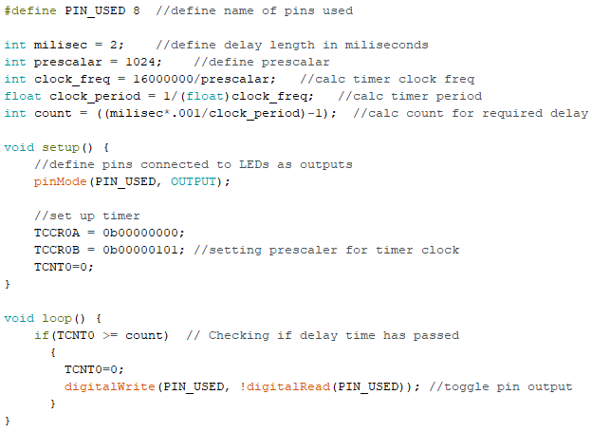
Problem Statement 1
Make an LED blink every 2 millisecond while using Arduino system frequency (F_CPU) 16 MHz, using a timer to generate the delay without any application of the delay() function. Delay = 1 ms, so Timer0 can be used with pre-scalar 1024.
Number of count needed to reach 2 ms = (2,000 μs/64 μs) – 1 = 31.25 – 1 ≈ 31.
WGM01 and WGM00 set to zero for normal mode
WGM02 set to zero for normal mode, CS02, CS01, CS00 set to 1,0,1 for pre-scalar 1024
Make LED blink

Slide 17
Problem Statement 2
Make an LED blink every 2 seconds while using Arduino system frequency (F_CPU) 16 MHz, using a timer to generate the delay without any application of the delay() function.
Delay = 2 s, so Timer1 (remember that it is a 16-bit timer) can be used with the pre-scalar value of 1024.
Number of count required to get a delay of 2 s = (2,000,000 μs/64 μs) – 1 = 31,249.

Slide 18
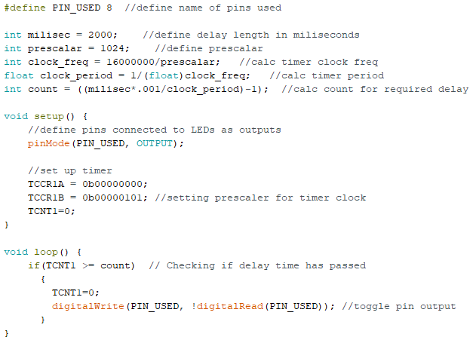
Code:
Same code, only register names have 1 instead of 0, and the delay length changed!

Slide 19
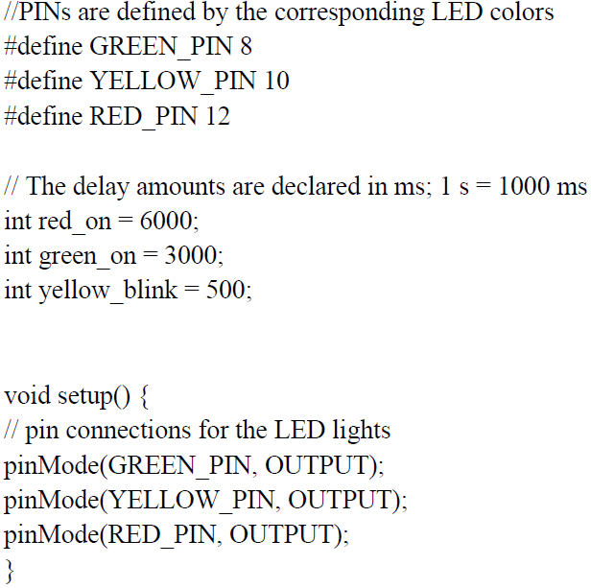
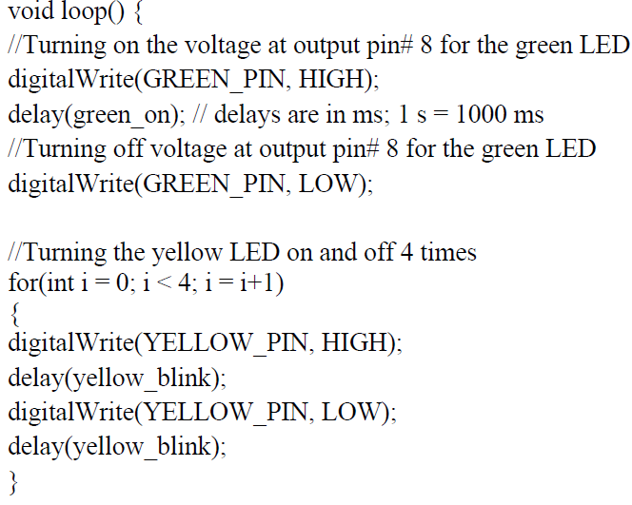
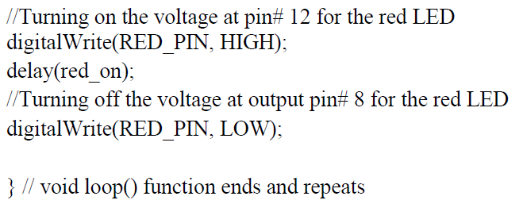
Previously used code in Exp. 1
To-do list:
Initialize timer registers
Write a new delay function using a timer
Change the marked lines

Slide 20
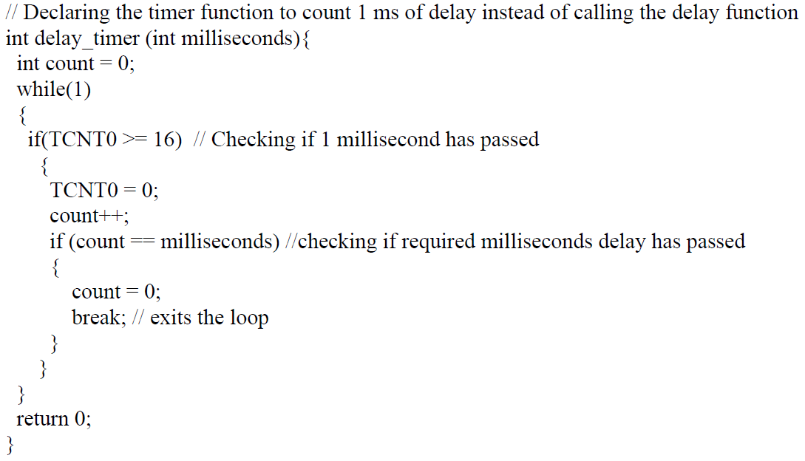
Modified Code using Timer Function

Slide 21
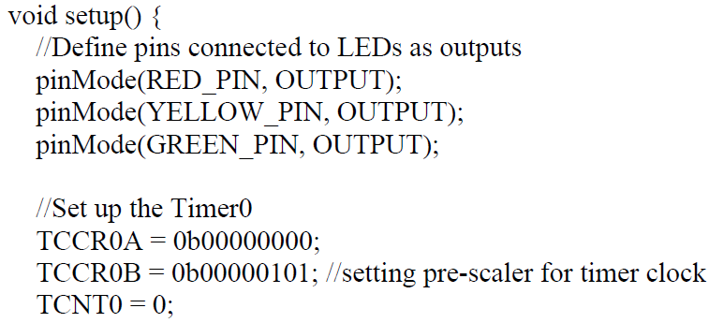
Modified Code using Timer

Slide 22
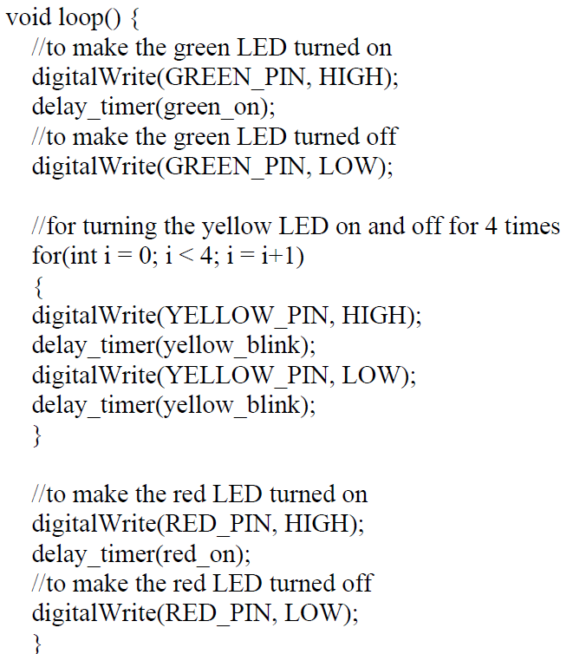
Modified Code using Timer
Change the marked lines with the new function, delay_timer().

Slide 23
References
ATMega328 manual
https://www.avrfreaks.net/forum/tut-c-newbies-guide-avr-timers
http://maxembedded.com/2011/06/avr-timers-timer0/

Slide 24
Thanks for Attending….
?

